Slide 1

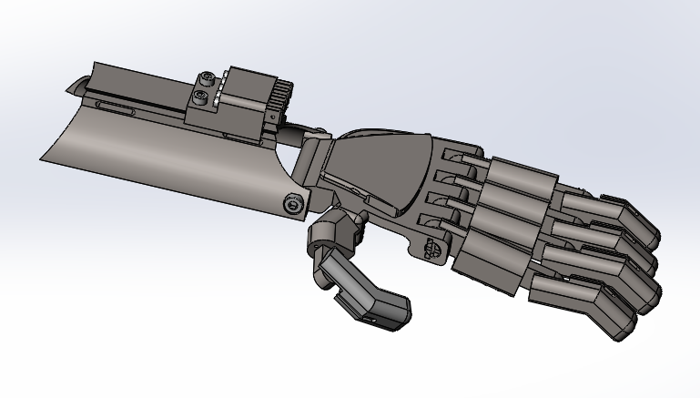
Improved 3D Printable Prosthetic Hand
Ryan Aday
Mechanical Engineering ’23
Georgia Institute of Technology

Slide 2
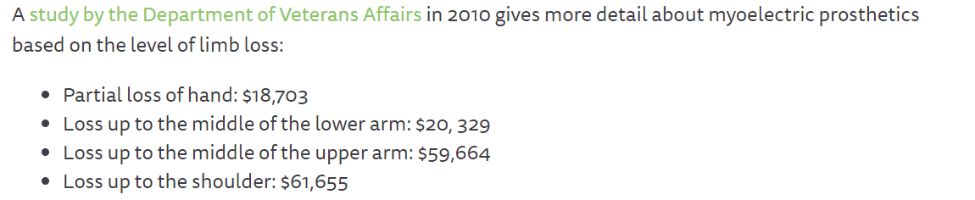
What is the Problem?
Traditional prosthetics are wildly expensive
Current 3D printable prosthetics aren’t durable enough/uncomfortable
Most open designs are hard to edit
3D Printers have become more cheap
The ability to function with the loss of a limb shouldn’t need to come from a steep price
One size doesn’t fit all for many prosthetics
Why Should We Care?

Slide 3
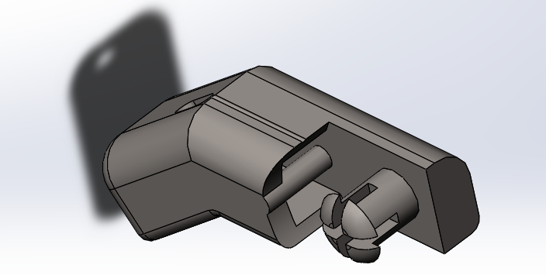
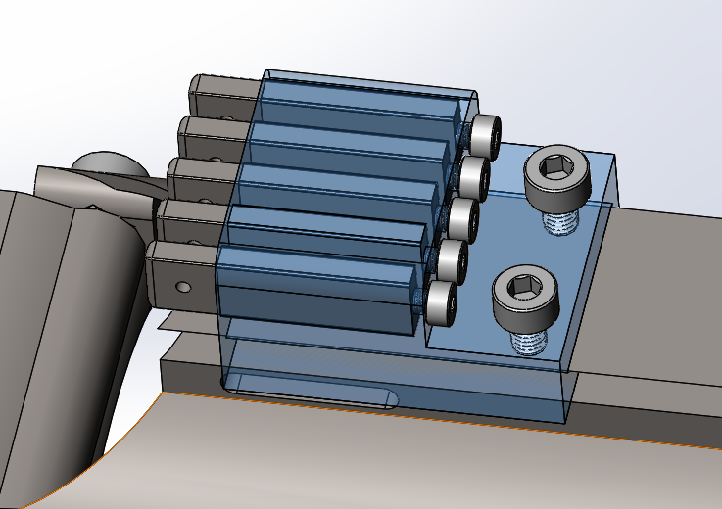
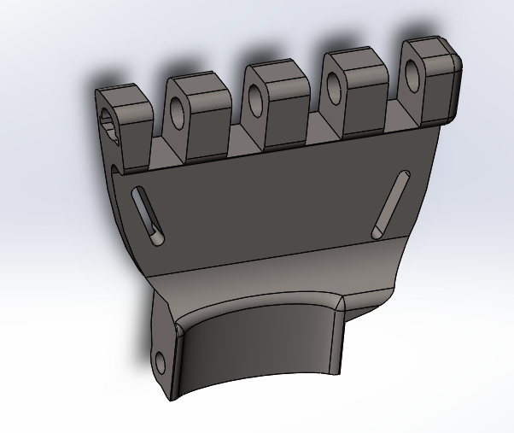
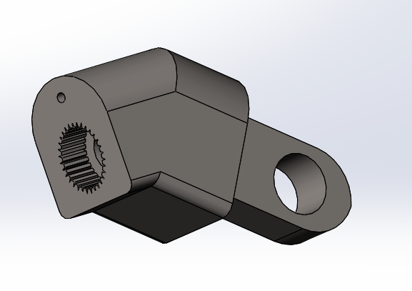
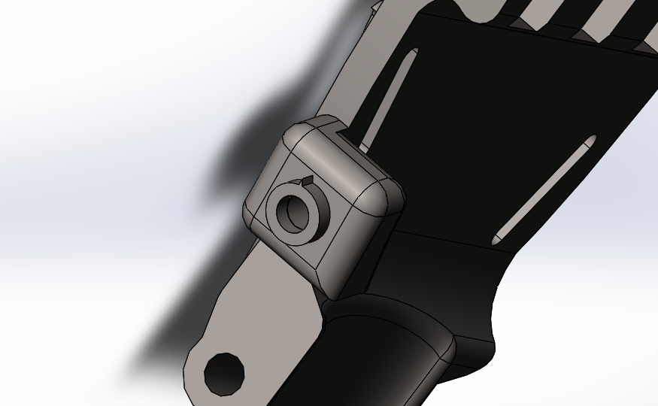
What Have I Done/ What Is My Invention?
Inelastic string (i.e. fishing line) run through a tensioner to fingers
Fingers move by flexing wrist
Redesigned the fingers to revolve around thicker joints
Used as few bolts as possible while using 3D printed joints/shafts to reduce outside expenditures
Added textures to fingers for more grip
Made housing more ergonomic for the hand
Made an easy tensioning system that is more robust and secure
Easy mounting system to palm using Velcro strips mounted optimally for slippage prevention
Prevented exposed string to avoid them getting caught
Used a friction gear system for full articulation of the thumb joint
Entire hand can be printed in two large prints- roughly 24 hours

Slide 4
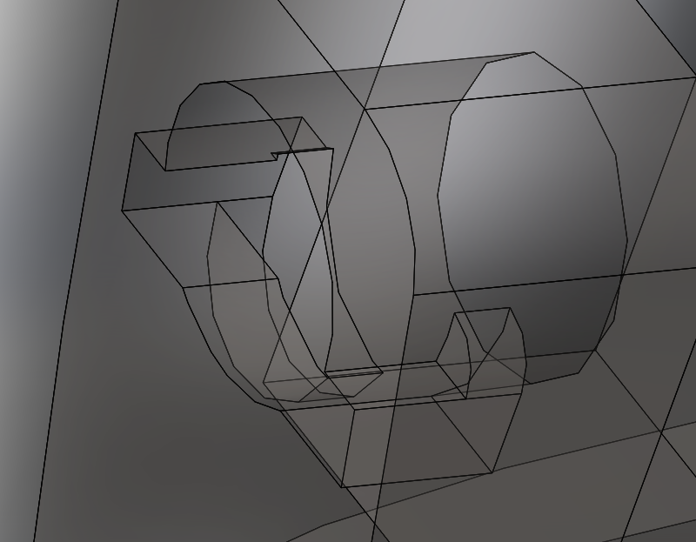
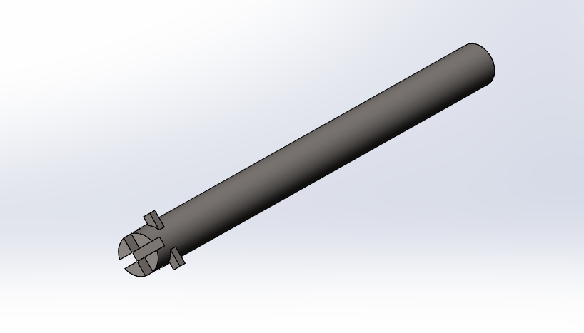
What Is the Usefulness/ Non-Obvious Applications?
When parts eventually fail, they are hot-swappable and quick to print
The raw .SLDPRT and .SLDASM files are available on my GitHub to be downloaded and edited: https://github.com/ryan-aday/Prosthetic_Hand
Confusion over editing parts can be addressed through my website: https://ryanaday.wixsite.com/mysite/prosthetic-hand
As few bolts are needed as possible
Easy thumb articulation means a variety of grips without the need for complicated setup
Main finger joint is one 3D printable shaft with a keyway built into the palm
Saves a lot of print time and failed prints
Convenient to remove and replace a part

Slide 5


What Is the Impact/Market?
Superior 3D printable hand allows for greater individual autonomy with less maintenance
Easy-to-edit files means better fitting custom prosthetic hands that are far better than a ‘one size fits all’ model
A hot-swappable part mechanic for a prosthetic can have a multitude of applications in a working/personal environment
Main market for amputees looking for a prosthetic hand
General model for free to the public for easy access
Allows for popularity for the hand over other models + free testing from their downloads and day-to-day experiences with the hand
File access to be shared for a fee of $5 or more once prototype is finalized
General .STLs to be found on Thingiverse, PrusaPrinters, etc
Editable files to be bought then accessed on my GitHub/ different monetizable download site

